Slide 1
Recursion

Slide 2
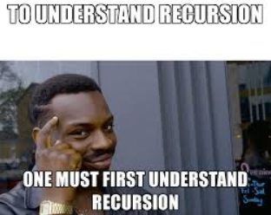
What is Recursion?

Slide 3
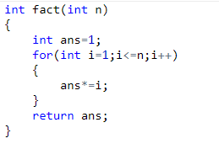
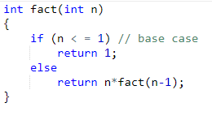
Introduction
The process in which a function calls itself is called recursion and the corresponding function is called as recursive function. Using recursive algorithm, certain problems can be solved quite easily.
In recursive program, the solution to base case is provided and solution of bigger problem is expressed in terms of smaller problems.
In the above example, base case for n < = 1 is defined and larger value of number can be solved by converting to smaller one till base case is reached.
Iterative
Recursive

Slide 4
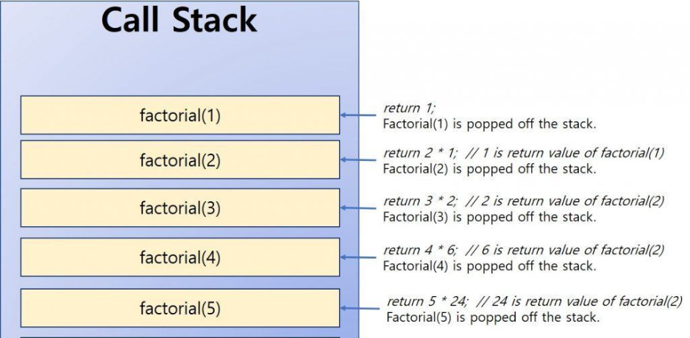
T(N) = O(N)
S(N) = O(N)

Slide 5
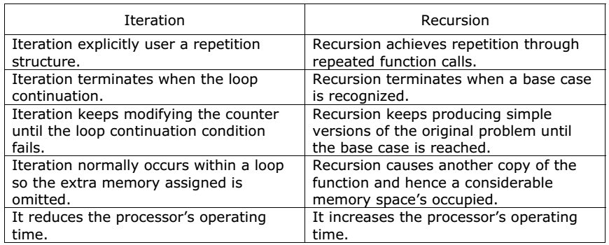
Iterative Vs Recursive

Slide 6
Solving Problems using Recursion
The idea is represent a problem in terms of one or more smaller problems, and add one or more base conditions that stop recursion. For example, we compute factorial n if we know factorial of (n-1). Base case for factorial would be n = 0. We return 1 when n = 0.
int fact(int N)
{
if (N == 0)
return 1;
return N*fact(N-1);
}

Slide 7
Why Stack Overflow error occurs?
If base case is not reached or not defined, then stack overflow problem may arise. Let us take an example to understand this.
int fact(int n) { // wrong base case (it may cause stack overflow). if (n == 100) return 1; else return n*fact(n-1);
}
If fact(10) is called, it will call fact(9), fact(8), fact(7) and so on but number will never reach 100. So, the base case is not reached. If the memory is exhausted by these functions on stack, it will cause stack overflow error.

Slide 8
Memory Allocation
When any function is called from main(), the memory is allocated to it on stack.
A recursive function calls itself, the memory for called function is allocated on top of memory allocated to calling function and different copy of local variables is created for each function call.
When the base case is reached, the function returns its value to the function by whom it is called and memory is de-allocated and the process continues.

Slide 9
Contd.
Example:
void printFun(int test)
{
if (test < 1)
return;
else
{
print test;
printFun(test-1); // statement 2
print test;
return;
}
}

Slide 10
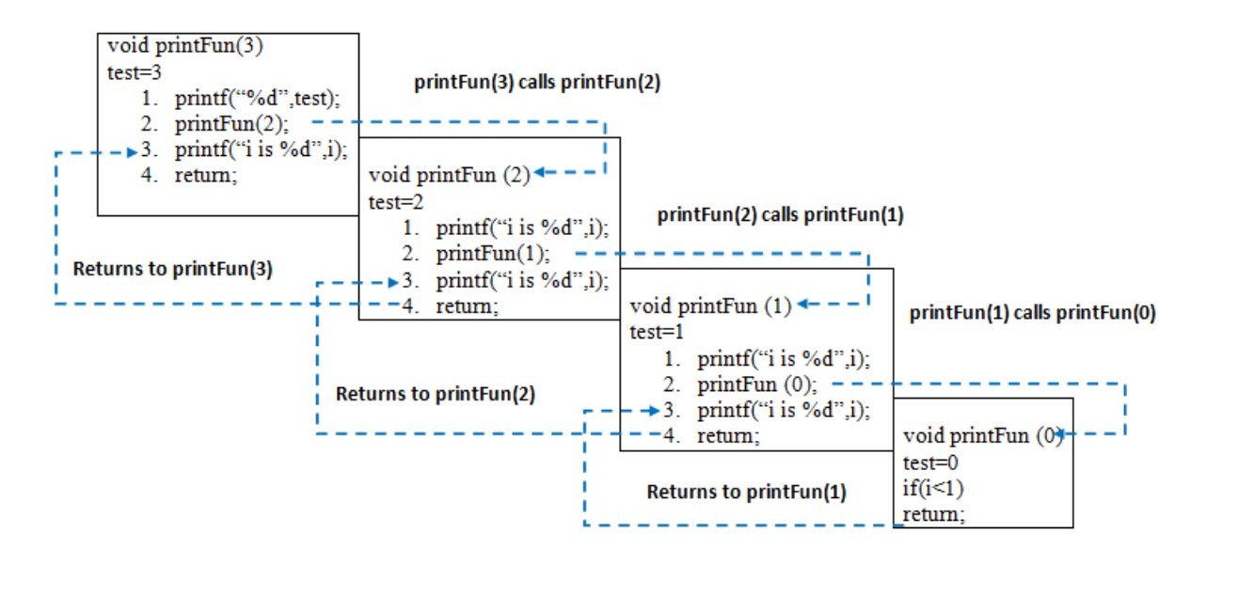
Memory Stack Visualization
When printFun(3) is called from main(), memory is allocated to printFun(3) and a local variable test is initialized to 3 and statement 1 to 4 are pushed on the stack. It first prints ‘3’.
In statement 2, printFun(2) is called and memory is allocated to printFun(2) and a local variable test is initialized to 2 and statement 1 to 4 are pushed in the stack.
Similarly, printFun(2) calls printFun(1) and printFun(1) calls printFun(0).
printFun(0) goes to if statement and it return to printFun(1).
Remaining statements of printFun(1) are executed and it returns to printFun(2) and so on. In the output, value from 3 to 1 are printed and then 1 to 3 are printed.

Slide 11
Tail Recursion
A recursive function is said to be following Tail Recursion if it invokes itself at the end of the function. That is, if all of the statements are executed before the function invokes itself then it is said to be following Tail Recursion. For eg:
void printN(int N)
{
if(N==0)
return;
else
cout<<N<<" ";
printN(N-1);
}
N = 5 will print:
5 4 3 2 1

Slide 12
Non-tail Recursive to Tail Recursive
int fact(int N)
{
if (N == 0)
return 1;
return N*fact(N-1);
}
Consider the function to calculate factorial of N. It is a non-tail-recursive function. Although it looks like a tail recursive at first look. If we take a closer look, we can see that the value returned by fact(N-1) is used in fact(N), so the call to fact(N-1) is not the last thing done by fact(N).
The above function can be written as a tail recursive function. The idea is to use one more argument and accumulate the factorial value in second argument. When N reaches 0, return the accumulated value.
int factTR(int N, int a)
{
if (N == 0)
return a;
return factTR(N-1, N*a);
}

Slide 13
Problem:
Given an unsorted array of N elements and an element X. The task is to write a recursive function to check whether the element X is present in the given array or not.
bool recursiveSearch(int arr[], int l,
int r, int x)
{
if (r < l)
return false;
if (arr[l] == x)
return true;
if (arr[r] == x)
return true;
return recursiveSearch(arr, l + 1,
r - 1, x);
}
// arr[] is the given array
// l is the lower bound in the array
// r is the upper bound
// x is the element to be searched for
// l and r defines that search will be
// performed between indices l to r

Slide 14
Exercise:
1. Check is a given string is palindrome or not using recursion. Analyse the space and time complexity of the solution
2. Find sum of all the elements in an array using recursion.

